Slide 1
BUILDING AN COGNITIVE AI

Slide 2
BUILD A SIMPLE CHATBOT
Goal
Partner with agile coach and Cloud Architect to build a chatbot?
Gain software development skills trained Watson service in 3 to 4 weeks.
Gain access to other developer tools to create a customized
What you get
You'll receive a Watson service ready to deploy to your organization's chatbot.
Your bot will be ready to engage customers with the following expertise:
— One area of expertise (e.g., automated product recommendations)
— Up to three business processes (e.g., Q&A, lead qualification)
— Up to five conversation branches related to each process (e.g., questions like "what plan should I purchase" or "what support do you offer for product X")

Slide 3
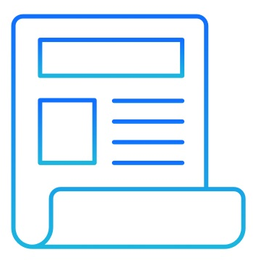
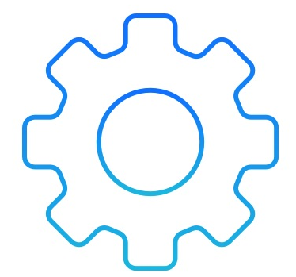
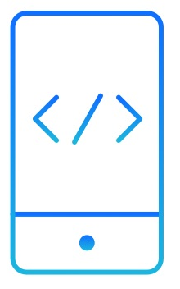
HOW IT WORKS
1. Provide requirements
    Start by outlining what capabilities you need and what unique business requirements you have for the bot.
    We will help you define 1 or 2 personas (avatars) to help develop use cases to train and validate chatbot responses
2. Develop & configure demo
Within weeks we will work with you to create a working demo to configure and train your chatbot solution using Watson Assistant.
3. Deploy solution to Cloud
  As a team we will deliver solution to production ready environment using the IBM Cloud
  n deploy to your company's environment.

Slide 4
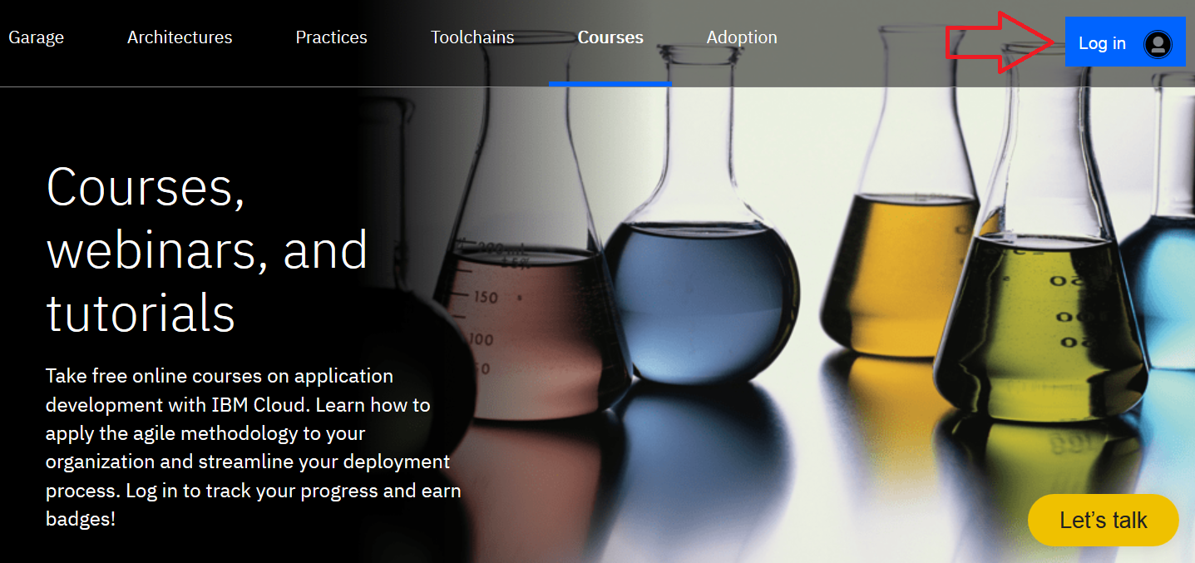
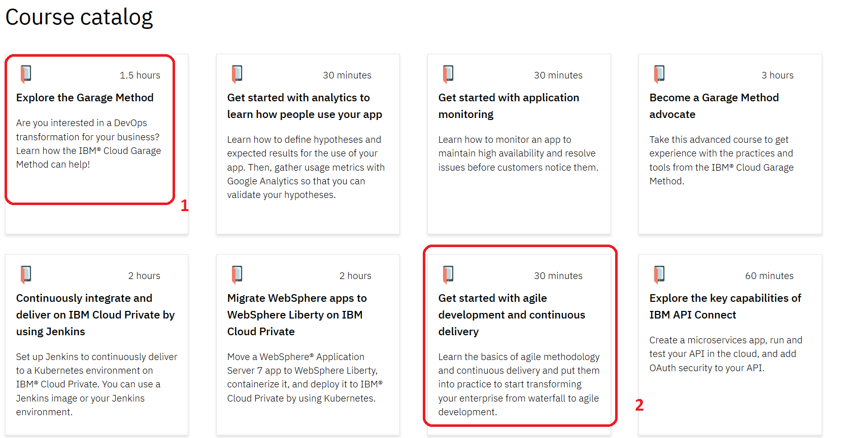
PREREQUISTIES
Create a free account on IBM Cloud
https://www.ibm.com/cloud/garage/category/courses
Once you have successfully logged in
Take the following courses (about 2 hrs)
  Explore the Garage Method
  Getting Started with agile development
2
2
2
https://www.ibm.com/cloud/garage/category/courses

Slide 5
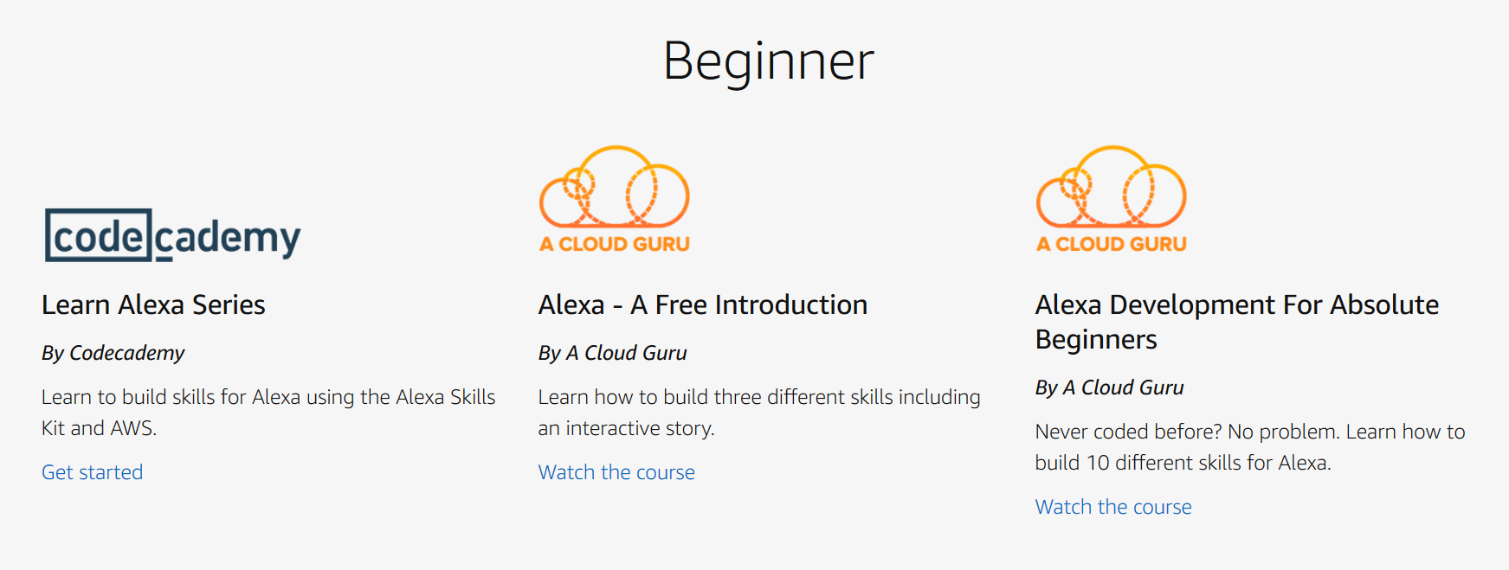
BASIC TRAINING
https://developer.amazon.com/alexa-skills-kit/alexa-skills-developer-training
Alexa – A Free Introduction

